Slide 1

Teaching Resources and Teacher Training
Southampton Confucius Institute Schools Forum
May 29th 2012
Xiaoming Zhu
SSAT (The Schools Network)
Confucius Institute

Slide 2
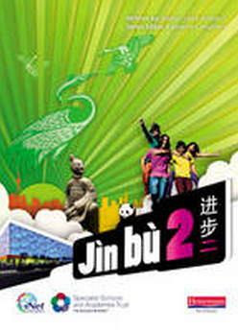
Teaching resources development
初级教材
进步 一
进步 二
Student book 学生用书
Teachers’ Guide 教师用书
Work book 练习册
Set of Audio CDs 听力练习CD

Slide 3
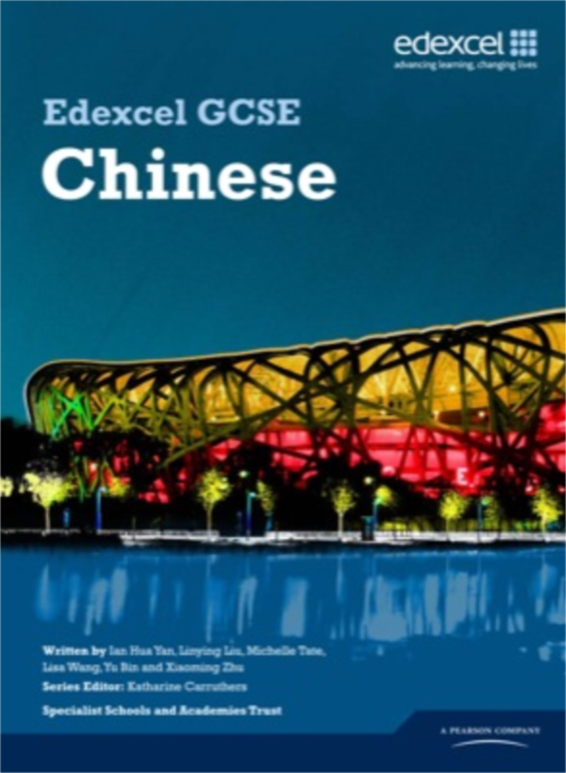
Teaching resources development
中学会考教材
Student book 学生用书
Teachers’ Guide 教师用书
Set of Audio CDs 听力练习CD
Assessment Pack 习题册
Notes:
NC; Exam syllabus, local students

Slide 4

1. Annual Chinese Conference
2. UK based course
3. China based course
4. Support to PGCE course and teacher placement
5. Hanban teacher CPD

